Slide 1
Bridging Openclinica to Epihandy

Slide 2
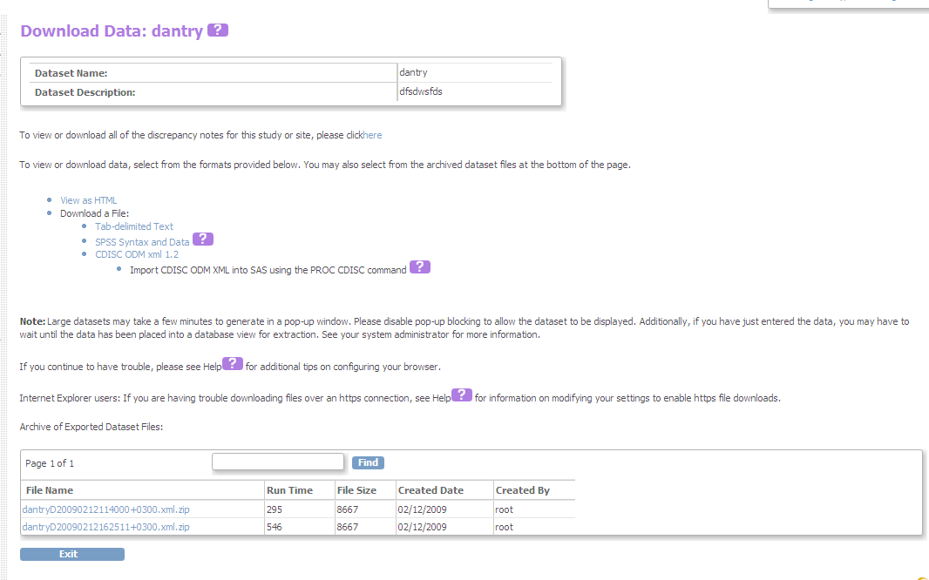
Export ODM file from Openclinica

Slide 3
Convert ODM File TO Xform
Run a tool that converts ODM to Xform definition
Then browse for ODM file using the tool
Then convert and save with the new name on the file system.

Slide 4
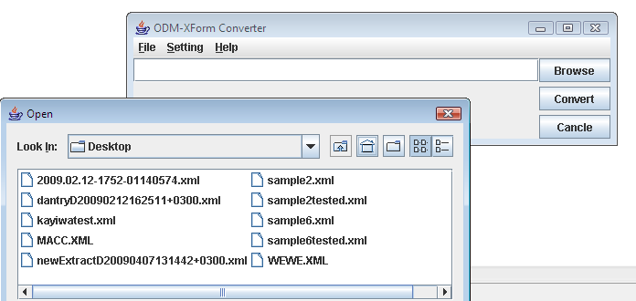
ODM to Xform Converter tool

Slide 5
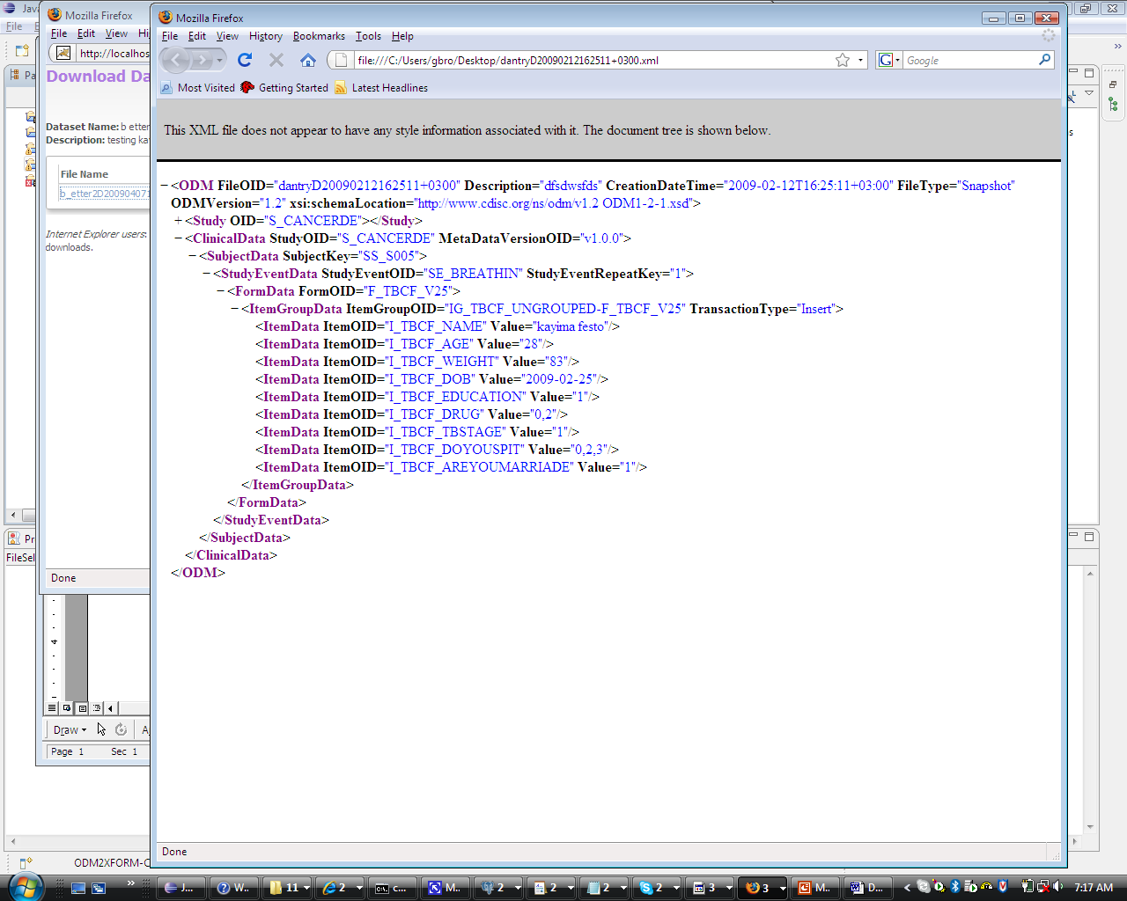
ODM file before Conversion

Slide 6
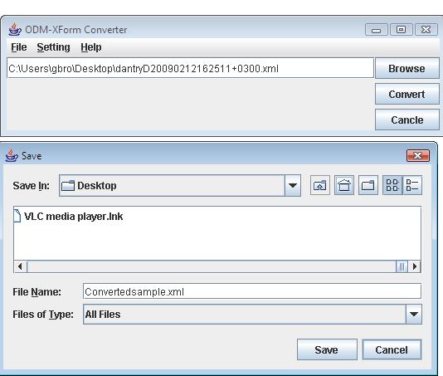
Save to System File

Slide 7
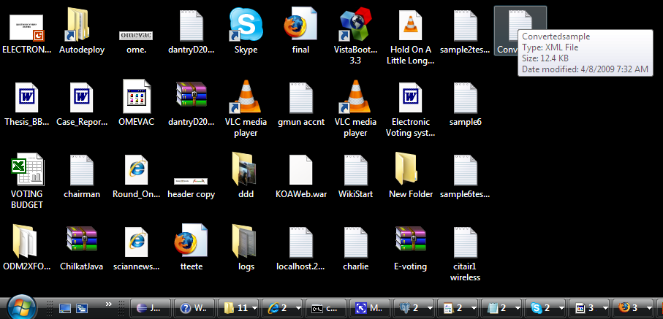
Xform Definition file on Desktop

Slide 8
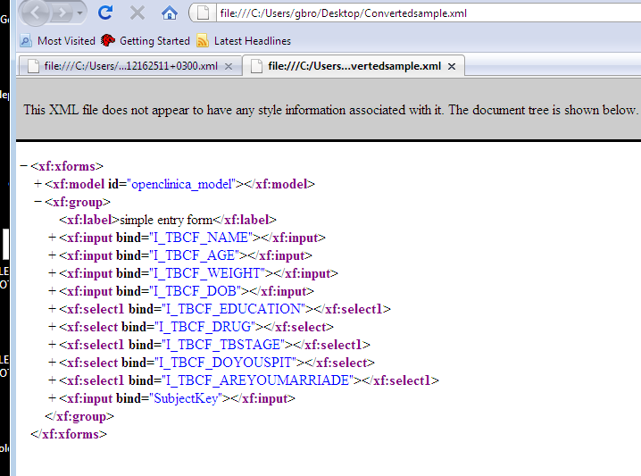
Xform definition (after)

Slide 9
DownLoad Xform to Mobile
The xform definition is downloaded to amobile device, either by use of bruetooth, http service, from epihandy server
The form is filled
Uploaded back to server
The uploaded data is saved as an ODM file with data

Slide 10
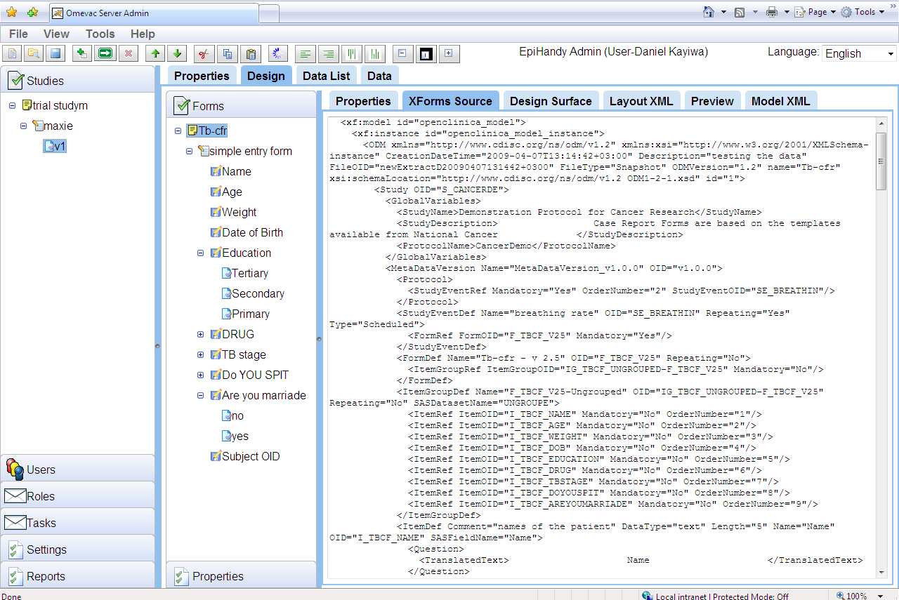
Epihandy Server Side

Slide 11
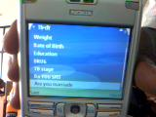

Dowloaded form on Mobile

Slide 12
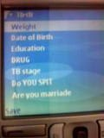
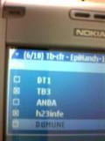
Filled form with data

Slide 13
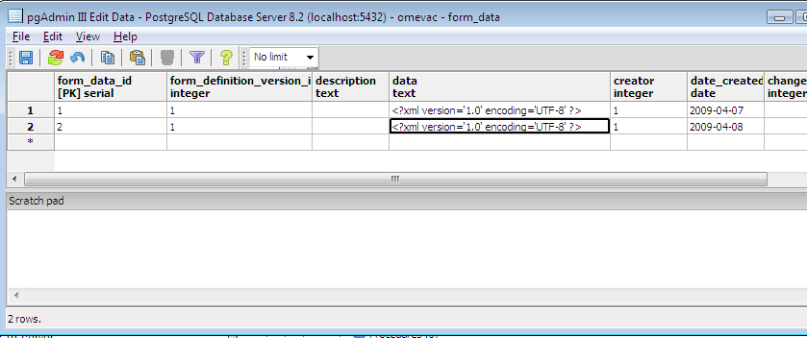
Uploaded ODM with data to Epihandy server

Slide 14
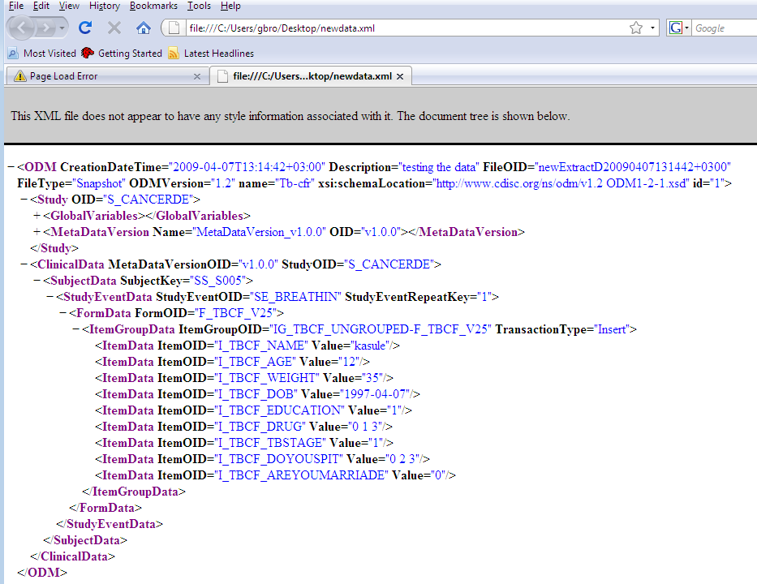
New Data

Slide 15
Converting to Openclinica Format
Changing the mult-select data to the format that openclinica accepts
Remove unwanted data
Reorganising the file content
Saving the content to file system with a anew name
Uploading data back to Openclinica

Slide 16
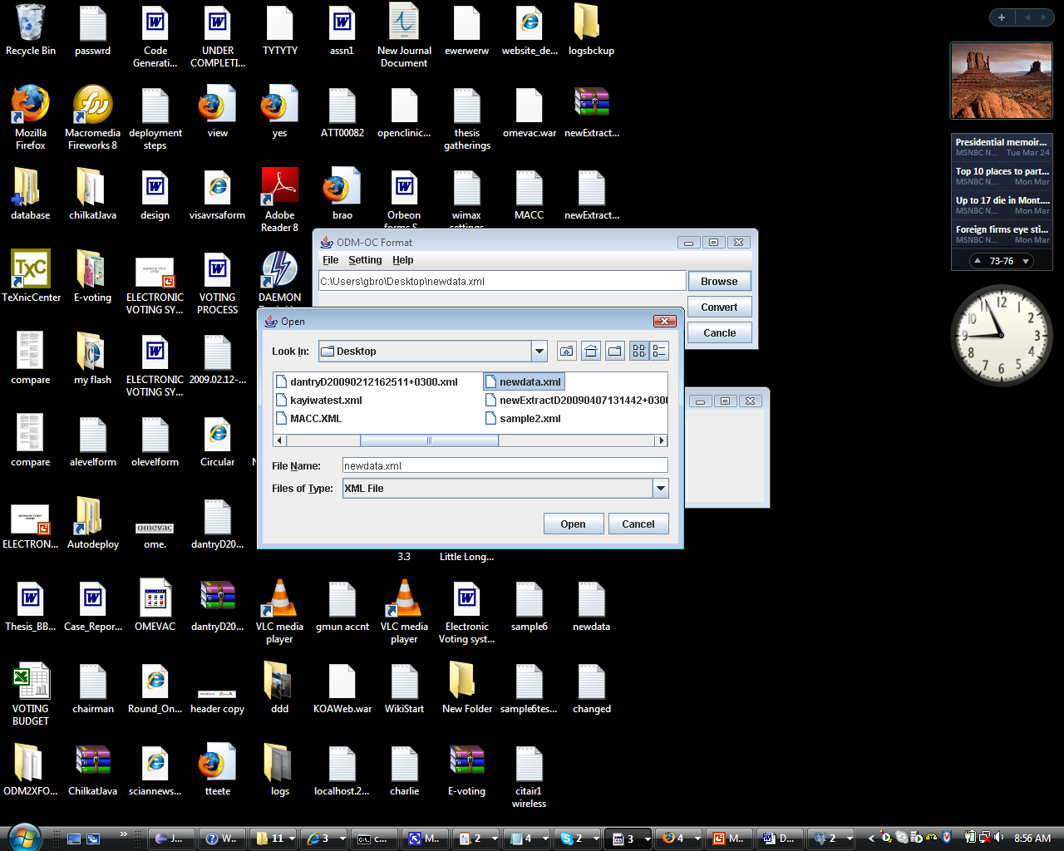
ODM to Openclinica format tool
The tool performs the above tasks

Slide 17
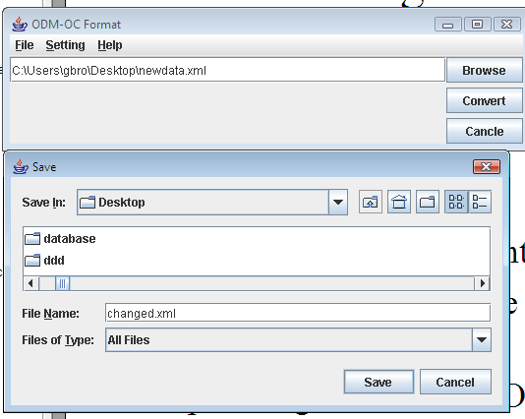
Save to FileSystem

Slide 18
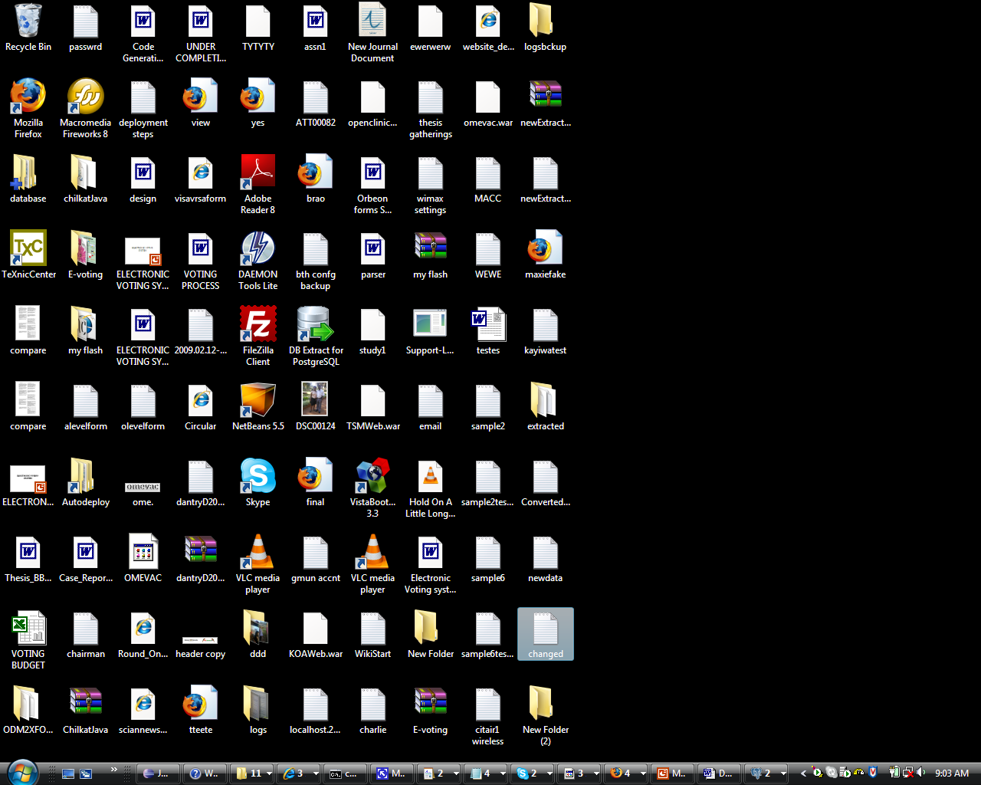
Saved Converted file on Destop

Slide 19
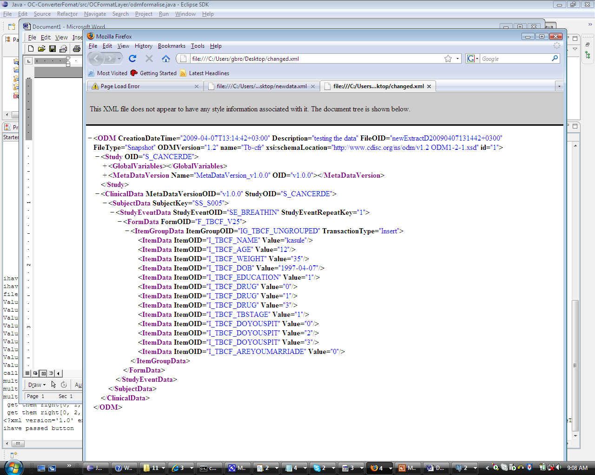
Changed data to Openclinica Format

Slide 20
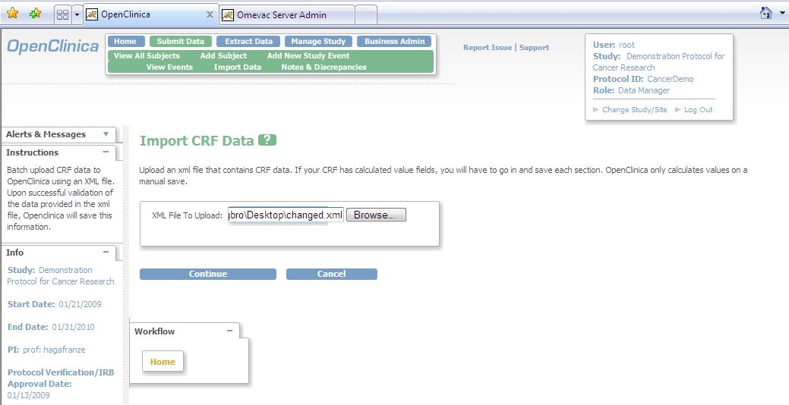
Upload file data back to openclinica

Slide 21
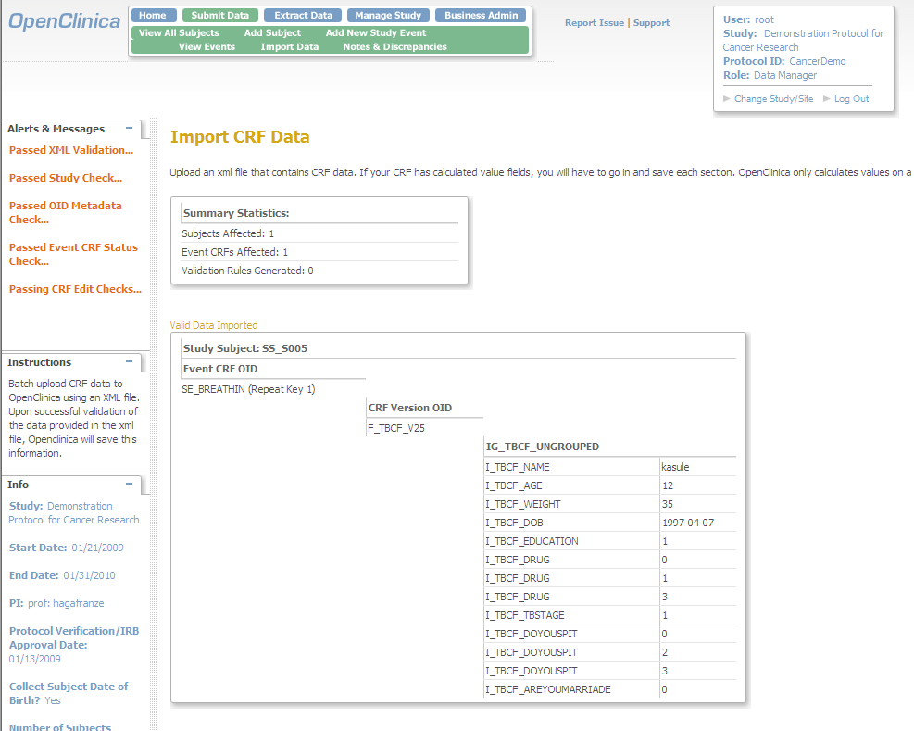
Proof checks the data format Before inserting data to database

